Slide 1
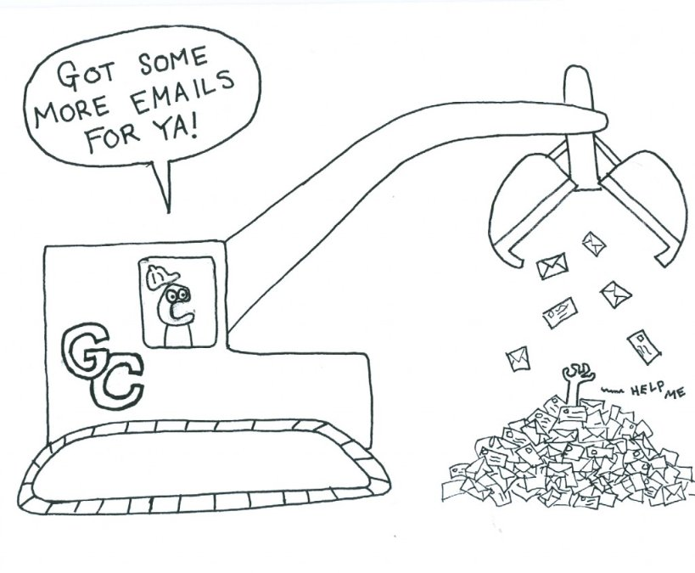
Plug-N-Harvest
WP7 - project MANAGEMENT
ORGANIZATION: Centre for Research & Technology Hellas / CERTH PRESENTER(S): CHRISTOS RAVANIS MEETING: Kickoff Meeting, Aachen, 21-22 September 2017

Slide 2
Project Monitoring
Day-to-day activities
Project Officer: Mrs. Dominique PLANCHON
Project Coordinator & Management: Prof. Elias KOSMATOPOULOS (CERTH)
Project Quality Assurance Manager: Dr. Dimosthenis IOANNIDIS (CERTH)
Project tasks & activities
Plenary Board (one representative from each beneficiary)

Slide 3
Coordinator’s Responsibilities
Administration, preparation of minutes and provision of the chairman of the Project Plenary Board and follow-up of its decisions.
Transmission of any documents and information connected with the Project between the Parties concerned.
Establishing detailed management plans for the Project including technical & quality management of the project achievements (deliverables, milestones, etc.)
Preparation of the periodic reports with cooperation of all the partners.
Day to day running of the Project.

Slide 4
Project Management
Project Management and H2020 rules
Reimbursement rate - indirect costs
Costs categories - budget transfers
Payments
Keeping records - Timesheets
Monitoring (Checks, reviews & audits)
Periodic Reporting - Periodic Management Reports
Risk management and contingency planning
Data Management & IPR
Quality management scheme

Slide 5
Reimbursement rate

Slide 6
Indirect Costs
Total Costs = Direct Costs (Personnel & Other) + Indirect Costs (0,25 x Direct Costs)

Slide 7
Cost Categories

Slide 8
Eligible (Actual) Costs
They must be actually incurred by the beneficiary;
They must be incurred in the period set out in Article 3, with the exception of costs relating to the submission of the periodic report for the last reporting period and the final report (see Article 20 of the AMGA);
They must be indicated in the estimated budget set out in Annex 2;
They must be incurred in connection with the action as described in Annex 1 and necessary for its implementation;
They must be identifiable and verifiable, in particular recorded in the beneficiary’s accounts in accordance with the accounting standards applicable in the country where the beneficiary is established and with the beneficiary’s usual cost accounting practices;
They must comply with the applicable national law on taxes, labor and social security
They must be reasonable, justified and must comply with the principle of sound financial management, in particular regarding economy and efficiency
For more details, see Article 6 of the H2020 Annotated Model Grant Agreement ec.europa.eu/research/participants/data/ref/h2020/grants_manual/amga/h2020-amga_en.pdf

Slide 9
Purchasing goods, works & services
If necessary to implement the action, the beneficiaries may purchase goods, works or services.
The beneficiaries must make such purchases ensuring the best value for money or, if appropriate, the lowest price.
In doing so, they must avoid any conflict of interests (see Article 35 of the AMGA).
The beneficiaries must base their purchases on the ‘best value-for-money’ considering the quality of the service, good or works proposed (also called ‘best price-quality ratio’) or on the lowest price.
The best value-for-money principle does not require competitive selection procedures in all cases. (However, where a beneficiary did not request several offers, it must demonstrate how best value-for-money was nevertheless ensured.)

Slide 10
Budget categories Transfers (1)

Slide 11
Budget categories Transfers (2)

Slide 12
Payments

Slide 13
Keeping Records (Actual Costs)
Adequate records and other supporting documentation to prove the costs declared, such as:
contracts
subcontracts
invoices
accounting records
In addition, the beneficiaries’ usual cost accounting practices and internal control procedures must enable direct reconciliation between the amounts declared, the amounts recorded in their accounts and the amounts stated in the supporting documentation

Slide 14
Keeping Records (Timesheets)
For personnel costs (declared as actual costs or on the basis of unit costs)
The beneficiaries must keep time records for the number of hours declared
The time records must be in writing and approved by the persons working on the action and their supervisors, at least monthly.
In the absence of reliable time records of the hours worked on the action, the [Commission][Agency] may accept alternative evidence supporting the number of hours declared, if it considers that it offers an adequate level of assurance.
Exception
For persons working exclusively on the action, there is no need to keep time records, if the beneficiary signs a declaration confirming that the persons concerned have worked exclusively on the action

Slide 15
Monitoring: checks, reviews & audits
CHECKS
The Commission will — during the implementation of the action or afterwards — check the proper implementation of the action and compliance with the obligations under the Agreement, including assessing deliverables and reports.
REVIEWS
The Commission may — during the implementation of the action or afterwards — carry out reviews on the proper implementation of the action (including assessment of deliverables and reports), compliance with the obligations under the Agreement and continued scientific or technological relevance of the action.
Reviews may be started up to two years after the payment of the balance.
On the basis of the review findings, a ‘review report’ will be drawn up. The Commission will formally notify the review report to the coordinator or beneficiary concerned, which has 30 days to formally notify observations (‘contradictory review procedure’).
AUDITS
Audits normally concern mainly the financial implementation of the action by a beneficiary (i.e. financial and budgetary implementation), but may also cover technical aspects or compliance with other obligations under the GA.
The Commission may — during the implementation of the action or afterwards — carry out audits on the proper implementation of the action and compliance with the obligations under the Agreement. Audits may be started up to two years after the payment of the balance.

Slide 16
Monitoring: Project reviews
Reviews normally concern mainly the technical implementation of the action (i.e. its scientific and technological implementation), but may also cover financial and budgetary aspects or compliance with other obligations under the GA.
They consist in an in-depth examination (often done with the help of independent experts) of the progress of the action, and in particular:
the degree to which the work plan has been carried out and whether all deliverables were completed
whether the objectives are still relevant and provide scientific or industrial breakthrough potential
how resources were planned and used in relation to the achieved progress, and if their use respected the principles of economy, efficiency and effectiveness
the management procedures and methods of the action
the beneficiaries’ contributions and integration within the action
the expected potential scientific, technological, economic, competitive and social impact, and plans for using and disseminating results

Slide 17
Periodic Reporting (1)
M18 + 60 days
M36 + 60 days
M51 + 60 days
Project START Sept 2017
M18 Feb 2019
M36 Aug 2020
M51 Nov 2021

Slide 18
Periodic Reporting (2)
The periodic report must include the following:
(a) a ‘periodic technical report’ containing:
(i) an explanation of the work carried out by the beneficiaries;
(ii) an overview of the progress towards the objectives of the action, including milestones and deliverables identified in Annex 1.
This report must include explanations justifying the differences between work expected to be carried out in accordance with Annex 1 and that actually carried out.
The report must also detail the exploitation and dissemination of the results and — if required in Annex 1 — an updated ‘plan for the exploitation and dissemination of the results’;
The report must indicate the communication activities
(iii) a summary for publication by the Commision;
(iv) the answers to the ‘questionnaire’, covering issues related to the action implementation and the economic and societal impact, notably in the context of the Horizon 2020 key performance indicators and the Horizon 2020 monitoring requirements;

Slide 19
Periodic Reporting (3)
The periodic report must include the following:
(b) a ‘periodic financial report’ containing:
an ‘individual financial statement’ (see Annex 4) from each beneficiary, for the reporting period concerned.
an explanation of the use of resources and the information on subcontracting (see Article 13) and in-kind contributions provided by third parties (see Articles 11 and 12) from each beneficiary, for the reporting period concerned
a ‘periodic summary financial statement’ (see Annex 4), created automatically by the electronic exchange system, consolidating the individual financial statements for the reporting period concerned and including — except for the last reporting period — the request for interim payment.

Slide 20
Controls & Audits
Keep timesheets
Only real and actual costs
No sub-contracting between partners
Mind the depreciation

Slide 21
Project Management
Project Management and H2020 rules
Reimbursement rate - indirect costs
Costs categories - budget transfers
Payments
Keeping records - Timesheets
Monitoring (Checks, reviews and audits)
Periodic Reporting - Periodic Management Reports
Risk management and contingency planning
Data management & IPR
Quality management scheme

Slide 22
Periodic reporting in PnH
D7.1.1 (M6)
D7.1.2 [a,b,c] (M12, M24, M36)
D7.1.3 (M51)
The document (technical and financial progress) is also sent to the PO
Project reporting periods (M18, M36, M51)
Overview, including a publishable summary of the progress of work
An explanation of the use of the resources
Financial Statements (Form C)

Slide 23
Project Management
Project Management and H2020 rules
Reimbursement rate - indirect costs
Costs categories - budget transfers
Payments
Keeping records - Timesheets
Monitoring (Checks, reviews and audits)
Periodic Reporting – Periodic Management Reports
Risk management and contingency planning
Data management & IPR
Quality management scheme

Slide 24
Risk Management & contingency plan
Main Objectives
Identify (in early stages) risks per WP (WP leaders)
Provide list of risks (technical, scientific, legal, behavioural, etc.) and contingency plans
Provisional for each project outcome (software, etc.)
Utilizing established methodologies for risk analysis (failure mode, effects analysis)
Actions from partners
Inform of new identified risks to the PB
Enhance the original risks identified during the project preparation and propose corresponding mitigation measures (CERTH to request input from all partners until M3)
D7.2.2 Risk Assessment (M6)
D7.2.3 Ethical monitoring & Contingency Plans (M6)

Slide 25
Project Management
Project Management and H2020 rules
Reimbursement rate - indirect costs
Costs categories - budget transfers
Payments
Keeping records - Timesheets
Monitoring (Checks, reviews and audits)
Periodic Reporting – Periodic Management Reports
Risk management and contingency planning
Data management & IPR
Quality management scheme

Slide 26
Data Management Plan (1)
Describe:
what data the project will generate
whether and how it will be exploited or made accessible for verification and re-use
how it will be curated and preserved
Detailed report for the data management policy of the project
The Data Management Plan will be updated as part of WP6 activities, if necessary (M6, M24, M36)
D6.1.2 [a,b,c] (M6, M24, M36)

Slide 27
Data Management Plan (2)
Procedure :
CERTH will distribute a template (data identification form) to be filled in by all partners, with:
Indicative types of data that will be generated from their activities
Which types of data can be made publicly available and which not
Restricted access should be justified
How the data can be curated/preserved and made accessible for verification and reuse

Slide 28
Project Management
Project Management and H2020 rules
Reimbursement rate - indirect costs
Costs categories - budget transfers
Payments
Keeping records - Timesheets
Monitoring (Checks, reviews and audits)
Periodic Reporting – Periodic Management Reports
Risk management and contingency planning
Data management & IPR
Quality management scheme

Slide 29
Project Reference Manual & Quality Plan
Organizational structure of the project.
Co-ordination between the partners.
General measures and actions taken.
Planning & control.
Control of the documentation.
Quality control of the project.
Files and archives.
List of quality forms to be used.

Slide 30
Chair: Quality Assurance Manager (CERTH)
Project Coordinator (CERTH)
One expert (senior researcher) from each partner, not directly involved in the project – TBD internally
A list with all internal review assignments will be defined and distributed
An external reviewer (appointed by the QAM)

Slide 31
Each deliverable will be reviewed by 2 internal reviewers and the Quality Assurance Manager (CERTH)
*In special cases an external expert may be invited instead.
Total: 3 reviewers
If shortcomings in quality are found, the responsible task leader will be informed within a pre-defined period (max. 2 weeks), in order to be able to make amendments.

Slide 32
Each deliverable will be reviewed by 2 internal reviewers and the Quality Assurance Manager (CERTH)
*In special cases an external expert may be invited instead.
Total: 3 reviewers
If shortcomings in quality are found, the responsible task leader will be informed within a pre-defined period (max. 2 weeks), in order to be able to make amendments.

