Slide 1
Plug-N-Harvest
WP3 - Task 3.1: Intelligent Management and Control System (IMCS)
ORGANIZATION: Certh PRESENTER(S): DR. Iakovos michailidis MEETING: Kick-off Meeting, Aachen, 21 September 2017
Notes:
Greetings. Within the following slides i will present to you the foreseen IMCS module.

Slide 2
Plug-N-Harvest: Contact Information
Cordis Europa URL: http://cordis.europa.eu/project/rcn/211287_en.html
Project Acronym : PLUG-N-HARVEST
Project ID: 768735
Funded under: H2020-EU.2.1.5.2. - Technologies enabling energy-efficient systems and energy-efficient buildings with a low environmental impact
Project Start Date: 1st of September 2017
Duration: 51 months
List of Participants
1 | Centre for Research and Technology Hellas - CERTH
2 | Rheinisch-Westfaelische Technische Hochschule Aachen - RWTH
3 | Cardiff University – CU
4 | Aloumyl, Biomichania Alouminioy Anonimi Etairia - ALUMIL
5 | Sistemes Avancats De Energia Solar Termica Sccl - AIGUASOL
6 | Odin Solutions s.l. - ODINS
7 | SIEMENS SRL - SIE
8 | Etra Investigacion Y Desarrollo Sa - ETRA
9 | Energy Transitions Limited - ET
10 | Eco Intelligent Growth, SL - EIG
11 | Agencia De L'habitatge De Catalunya - AHC
12 | Perifieria Dytikhs Makedonias - RWM
13 | County Council Of The City And County Of Cardiff - CCC
Notes:
Again, here is a general piece of information regarding the project.

Slide 3
Plug-N-Harvest: Intelligent Management and Control System (IMCS)
The IMCS module corresponds to KO2 reflecting the activities foreseen within Task 3.1 (start in M4 - finish in M39).
The IMCS will be responsible for the energy management at the single-building scale.
Tasks 3.1 to 3.2 will constitute the EMS layer delivered in Task 3.5 together with the SSM layer.
Notes:
The IMCS module reflects activities foreseen in Task 3.1, starting in M4 and finishing in M39.
The IMCS module will be responsible for the energy management task at the single-building level.
Task 3.1 together with Task 3.2, 3.3, 3.4 will constitute the EMS layer as described before.

Slide 4
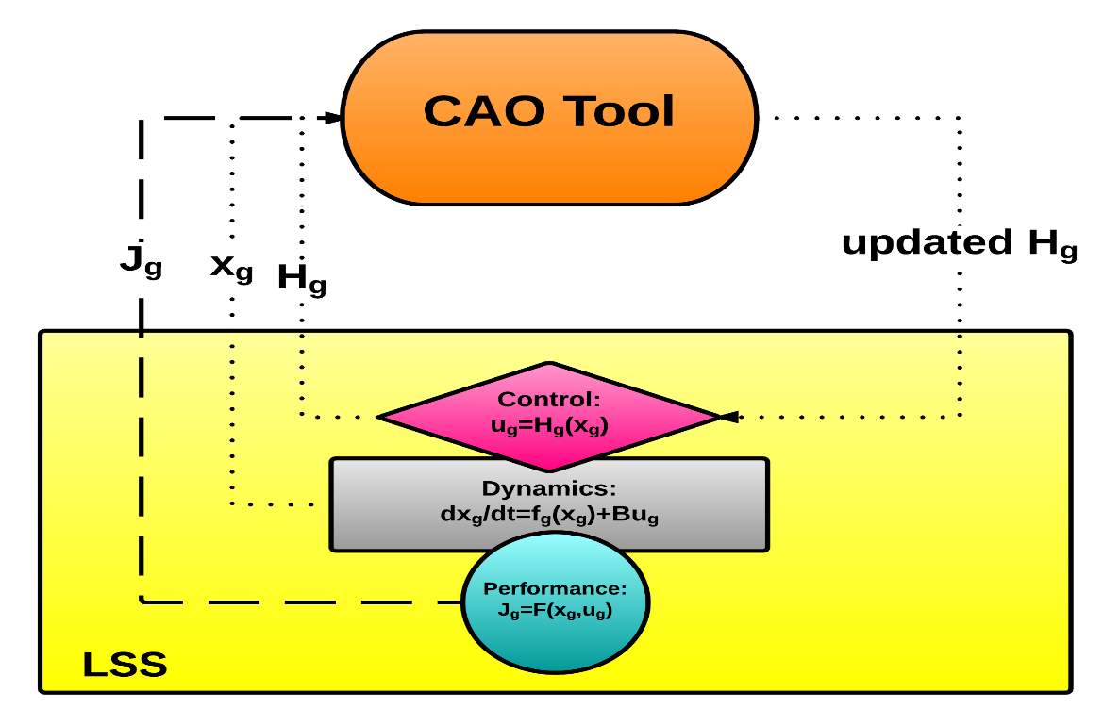
Plug-N-Harvest: CAO & IMCS
CAO tool will serve as the main ingredient for the IMCS module.
CAO is a scalable optimization tool capable of fine-tuning the applied control strategy on-the-go, without the requirement of any simulation model being available.
CAO tool has already been verified and extensively tested in several similar real-life cases within previous EU projects (current TRL 6).
Demo Cases | Period | Energy Savings (preserved comfort)
FIBP Kassel Building (24 Offices, 3 Floors, 260m²) | 12 Days | 25%
TUC Chania Building (10 Offices, 2 Floors, 150m²) | 6 Days | 25%
AFCON Tel-Aviv Building (210 Offices, 3 Floors, >2000m²) | 10 Days | 45%
RWTH Aachen Building (3 Conf. rooms, 1 Floor, 93m²) | 7 Days | 37%
Notes:
CAO tool will serve as the main ingredient for the IMCS module.
CAO is a scalable optimization tool, able to recalibrate the control strategy on-the-go without any simulation model’s assistance.
Note that CAO has already been verified and tested by CERTH during previous EU projects, reaching TRL 6.

Slide 5
Plug-N-Harvest: IMCS attributes
Plug-n-Play: preliminary calibration of parameters is not needed.
Model-Free: no simulation model to calculate the optimal decisions is required.
Automated-Calibration: no manual re-calibration during operation is needed.
Straightforward Configuration: easy reconfiguration during operation, without interruptions.
Situation Awareness: robust real-time reaction to emerging dynamics.
Inter-operability: compatible with common interfaces and operating systems..
Notes:
The main attributes IMCS will inherit from CAO are:
The fact that no initial calibration of the tool is required,
No model of the plant is required,
No manual re-calibration is required during operation,
Easy reconfiguration during operation
Robust real-time reaction to emerging dynamics.
Compatible with common interfaces and operating systems.

Slide 6
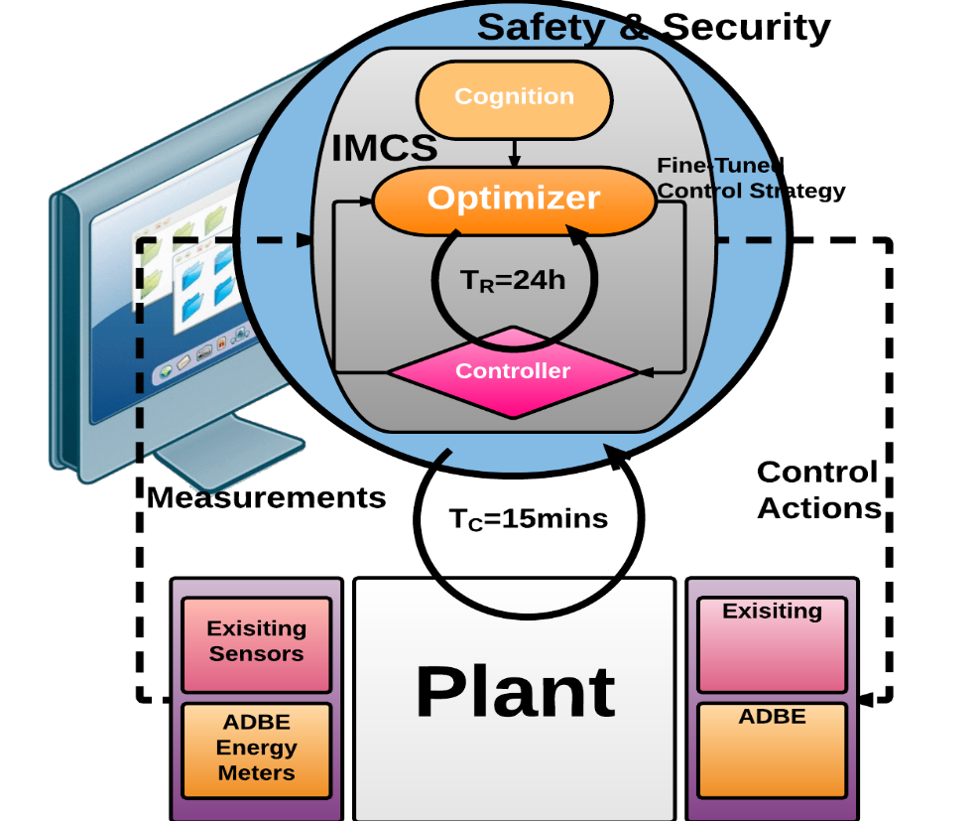
Plug-N-Harvest: IMCS workflow
Work-Flow: double, asynchronous, cycle operation A. a closed loop control strategy (T=15mins).
B. control recalibration on-the-go (T=24h).
Cost-criterion: combination of renewable energy consumption as a fraction of the total energy consumption and indoor thermal comfort levels.
$$J=w∙Comfort+ \left(1−w\right)∙Energy$$
Notes:
The workflow of the IMCS implements a double, asynchronous, cycle operation:
The first cycle considers a closed control loop operating usually at 10 to 15 mins period, driven by the system observations and weather conditions.
While the second cycle considers the recalibration of the control strategy at a periodic basis, usually every 24 hours.
Finally, the foreseen cost-criterion will be constituted by 2 factors:
the renewable energy consumption as a fraction of the total energy consumed,
And the indoor thermal comfort.

Slide 7
THANK YOU

